Slide 1
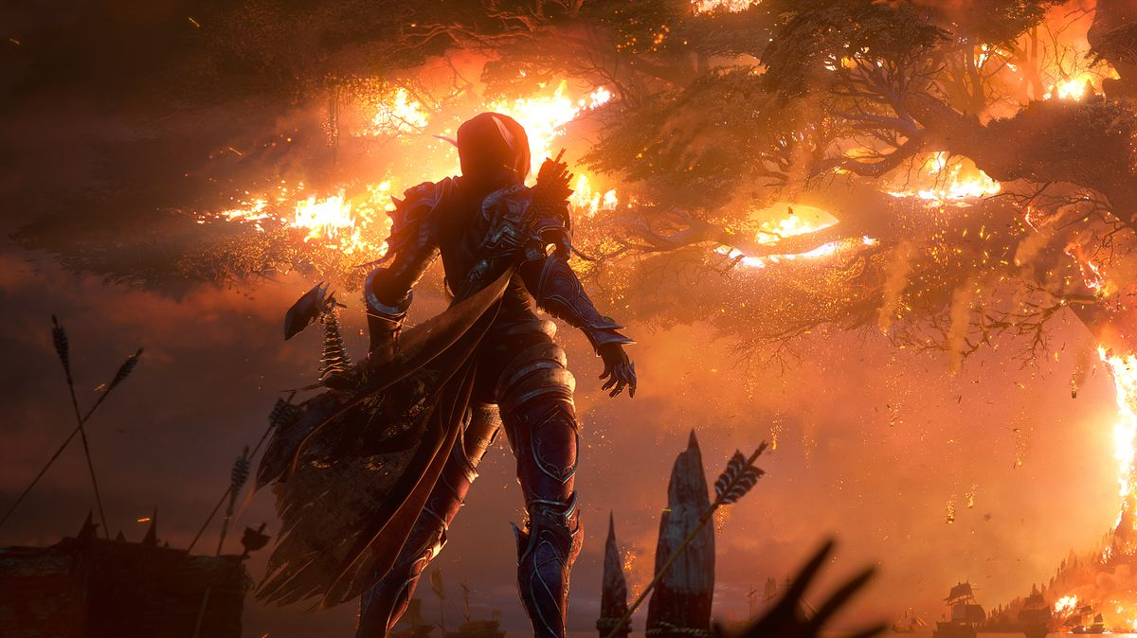
WORLD OF WARCRAFT PERSONALITY TEST
Alan Milliman, Irena Henry, Reese McCoy

Slide 2
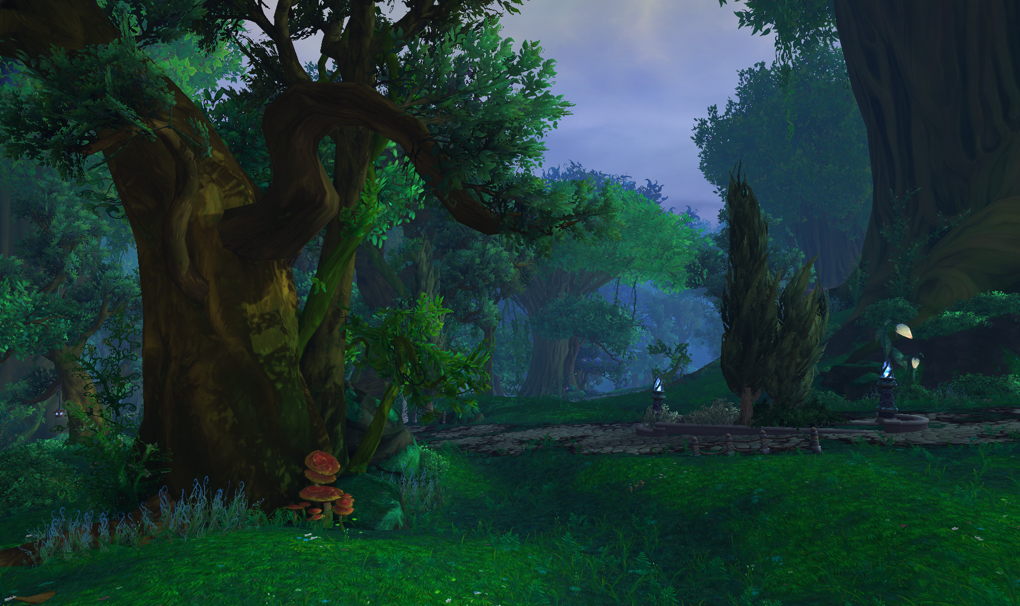
MAIN data structures:
Inheritance
Character superclass, Tank, Warrior, and Healer subclasses.
ArrayList
Used to store questions asked on the personality test.

Slide 3
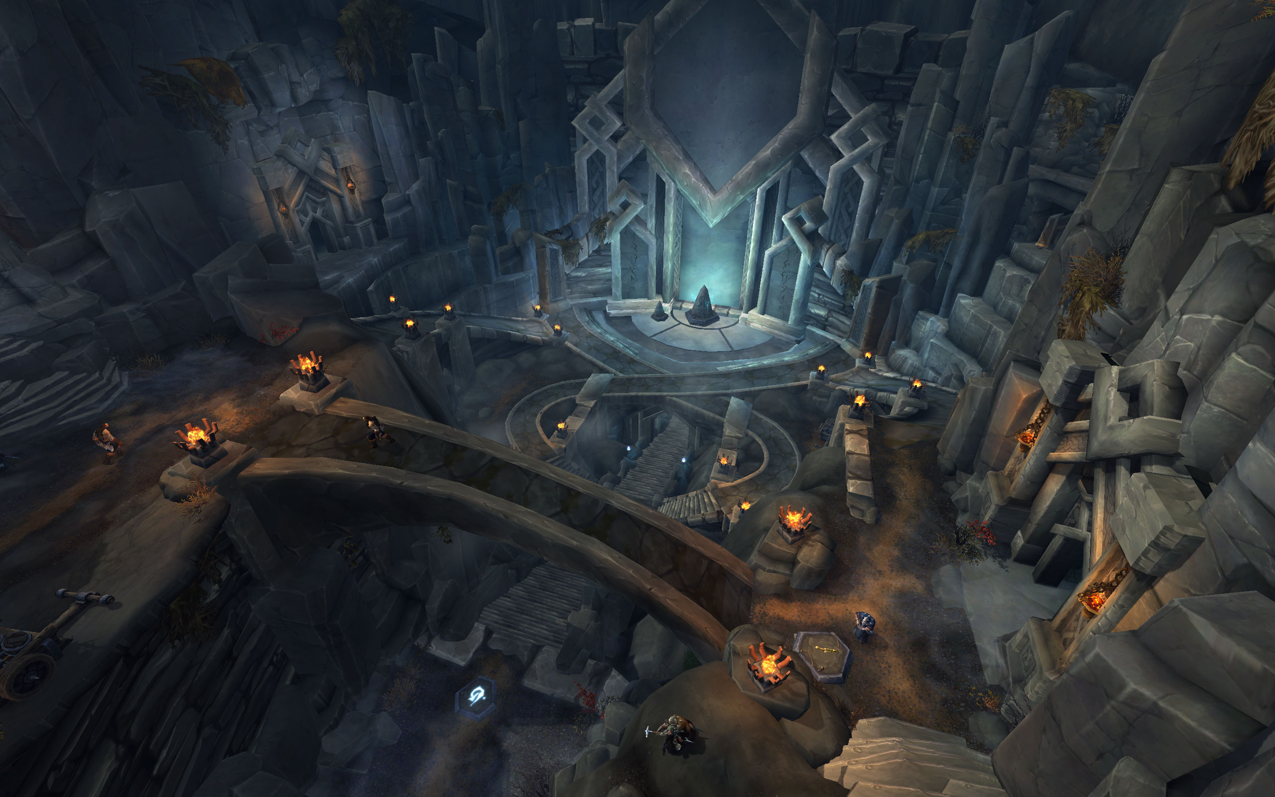
HOW IT works:
Eight personality questions are asked, each answer to every question gives you a point towards either the Tank class, Healer class, or the Warrior class. Points are tallied up as the questions are being asked, and your character class is assigned based on the final tally. (In case of a tie, a bonus question is given.) The image of your character is then displayed in a new JFrame panel window, and your statistics are printed to the console window.

Slide 4
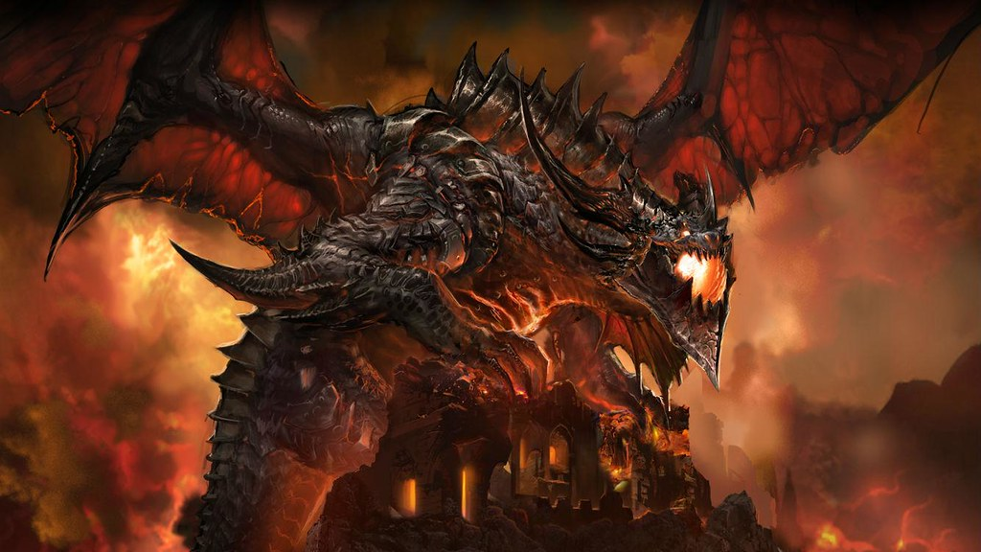
Challenges we faced:
Time
Obviously, getting things done before a certain deadline adds a little bit of pressure.
Putting our thoughts into action
Knew what we wanted to do for the most part, but took a little bit longer actually writing the code for it all.
Working with the JFrame
Had to look up a few things, such as how to "hotlink" the URL of an image to get it to show up in the JFrame window.

Slide 5
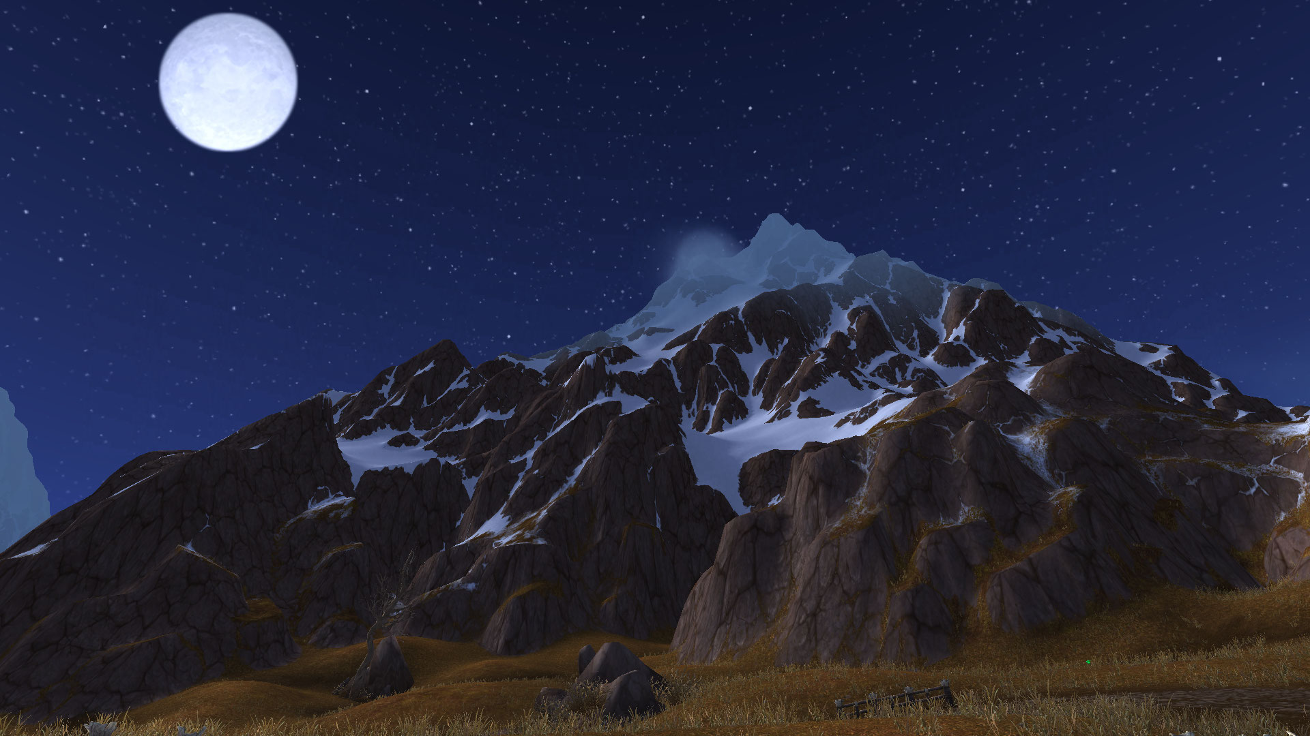
WHAT WE WOULD ADD IF WE HAD MORE TIME:
Character ability adjustment
A program to allow the user to change his or her character's statistics/abilities range, based on a point system where a base number of points for each ability is assigned to each character. The user would then get a remaining number of points to add to their character's abilities.
More subclasses
To narrow down the user's personality type as related to a World of Warcraft character even more.
Visual statistics representation
Adding the statistics and character name to the JFrame window

Slide 6
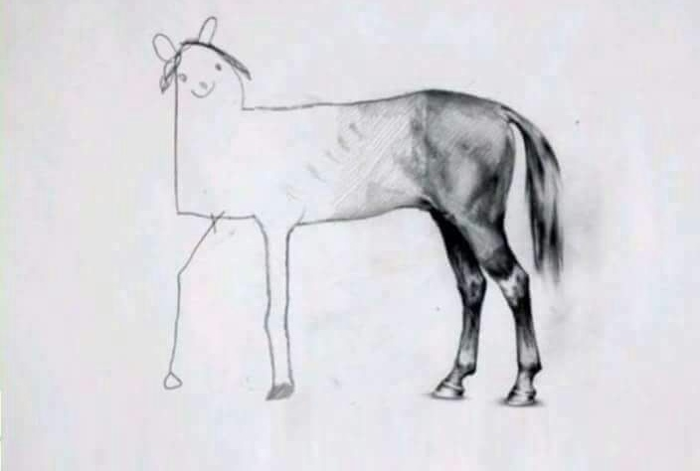
An accurate portrayal of trying to complete the code for a program before the project deadline.

